Slide 1
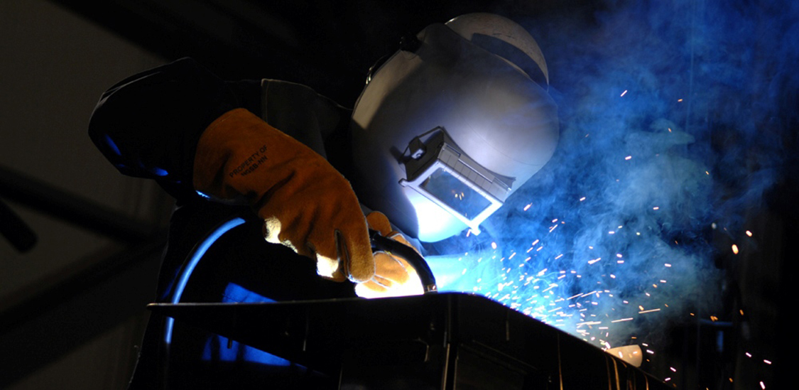
Temperature, Kinetic Theory, and the Gas Laws
NJ-OER TOPIC-13

Slide 2
Learning Outcomes
Convert temperatures between the Celsius, Fahrenheit, and Kelvin scales. Define, describe and calculate thermal expansion State the ideal gas law in terms of molecules and in terms of moles. Use the ideal gas law to calculate change in pressure, temperature, volume or the number of molecules or moles State the relationship between the kinetic energy, temperature and root mean square velocity of a gas Interpret a phase diagram. State Dalton’s law.

Slide 3
Concepts
𝑇𝐹 = Temperature in Fahrenheit T𝐶 = Temperature in Celsius 𝑇=TK=Temperature in Kelvin 𝛥𝐿=Expansion (Lf-L0) L = Original length 𝛼 = Coefficient of linear expansion 𝑘=universal Boltzmann constant R = 8.31 J/ (mole K) universal gas constant
P = Pressure
V= Volume
NA = Avogadro number
N= number of atoms or molecules
n= number of moles
m =mass of molecule in kg
M= molar mass in kg/mole
vrms = Root mean square of speed of a molecule

Slide 4
Units
SI UNITS Volume is in cubic meters“m³” Pressure is in Pascal “Pa” Temperature in Kelvin “K” Energy in Joules “J” vrms in meters per second “m/s” R is in J/ (mole K) K is in J/K

Slide 5
Formulas and Constants
TF= 9/5 TC +32 TK= TC +273.15 𝛥𝐿=𝛼𝐿𝛥𝑇 ΔA= 2𝛼AΔT ΔV=3𝛼VΔT 𝑃𝑉=𝑁𝑘𝑇 𝑃𝑉= 𝑛𝑅𝑇 P1 V1/(n1 T1)=P2 V2/(n2 T2) 𝑘=1.38×10−23 𝐽/𝐾 𝑅=8.31𝐽𝑚𝑜𝑙⋅𝐾 n/N=R/k=NA= 6.02×10²³ 𝑚𝑜𝑙−1 KE = 3/2 nRT = 3/2 NKT for monatomic gas vrms = sqrt (3RT/Mm) Mm is the molar mass

Slide 6
CLASSWORK FOR UNIT CONVERSIONS
Complete the table below for unit conversion using the given temperature
TF= 9/5 TC +32 TK= TC +273
TC(Celcius) | TF(Fahrenheit) | TK(Kelvin)
90 | ? | ?
? | 100 | ?
? | ? | 300
300 | ? | ?
? | 212 | ?
? | ? | 0
Solution for the first row: TK=90+273=363Kelvin TF=(9/5)90+32=204 Fahrenheit

Slide 7
CLASSWORK FOR THERMAL EXPANSION
Complete the table below
Object | Alpha | Initial Measurement | Ti | Tf | Change
Copper Wire | 16.7 10-⁶ | Length=? | 30 C | 230 C | ΔL=0.03
Aluminum Plate | 23.0 10⁻⁶ | L=5meters W=3meters | 70 degrees C | ? | ΔA= - 0.02 m²
Unknown Plate | ? | L=4 meters W=2meters | 23 C | 73 C | ΔA=0.005 m2
Copper Sphere | 16.7 10-⁶ | Radius 0.4 meters | 30 C | 70 C | ΔV=?
𝛥𝐿=𝛼𝐿𝛥𝑇 ΔA= 2𝛼AΔT ΔV=3𝛼VΔT V(sphere)=4/3 πr³
Model word problem for the first row: A copper wire is heated from 30 degrees celcius to 230 degrees Celcius. As a result it expanded by 0.03 meters. What was the original length.
Solution:0.03 = L (16.7 10^-6)(230-30) L=89.8 meters

Slide 8
IDEAL GAS
An ideal gas is a hypothetical gas composed of randomly moving point size gas molecules where interparticle interactions are negligeable.

Slide 9
CLASSWORK: IDEAL GAS STATES
𝑃𝑉=𝑁𝑘𝑇 𝑃𝑉= 𝑛𝑅𝑇 𝑘=1.38×10−23 𝐽/𝐾 𝑅=8.31𝐽𝑚𝑜𝑙⋅𝐾
Volume is in cubic meters“m³” Pressure is in Pascal “Pa” Temperature in Kelvin “K”
Q: Three moles of ideal gas has 100,000 Pascal pressure at 242 degrees Kelvin. What is its volume ?
n=3 P=100,000 V=? T=242 V=nRT/P V= 0.06 m³
Complete the table below, use unit conversion if necessary.
Pressure | Volume | number | Constant | Temperature
100,000 Pa | ? | 3 moles | R | 242K
1 atm | 0.2 m³ | ? | R | 600K
75 kPa | 0.15 gallon | ? | R | -10 Celcius
? | 8 10⁽⁻¹⁸⁾ m³ | 1000 molecules | k | 400 K
TK=TC+273 1 atm=101,325 Pascal 1kPa=1 kilopascal=1000 Pascal 1 Gallon=0.003785 m³

Slide 10
IDEAL GAS PROCESS EQUATION
P1 V1/(n1 T1) = P2 V2/(n2 T2)
This is a comprehensive equation for a gas going from State 1 to State 2
Each state has Pressure Volume Temperature and number of moles or molecules
If any of the variables is a constant, they could be crossed out
Above equation is unit independent, as long as units are consistent for both states. The only unit that must be used is Temperature in Kelvin.

Slide 11
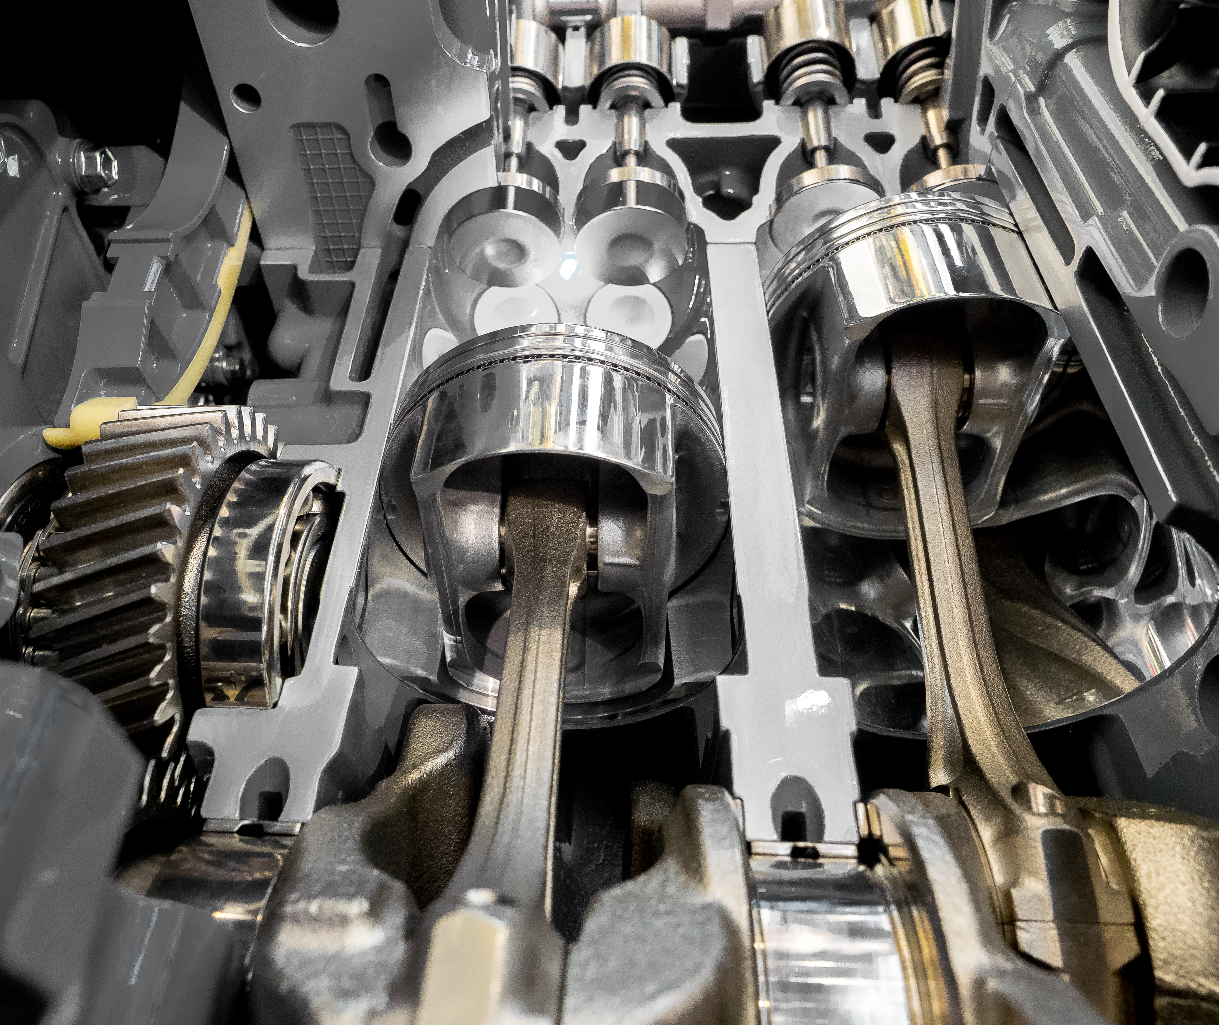
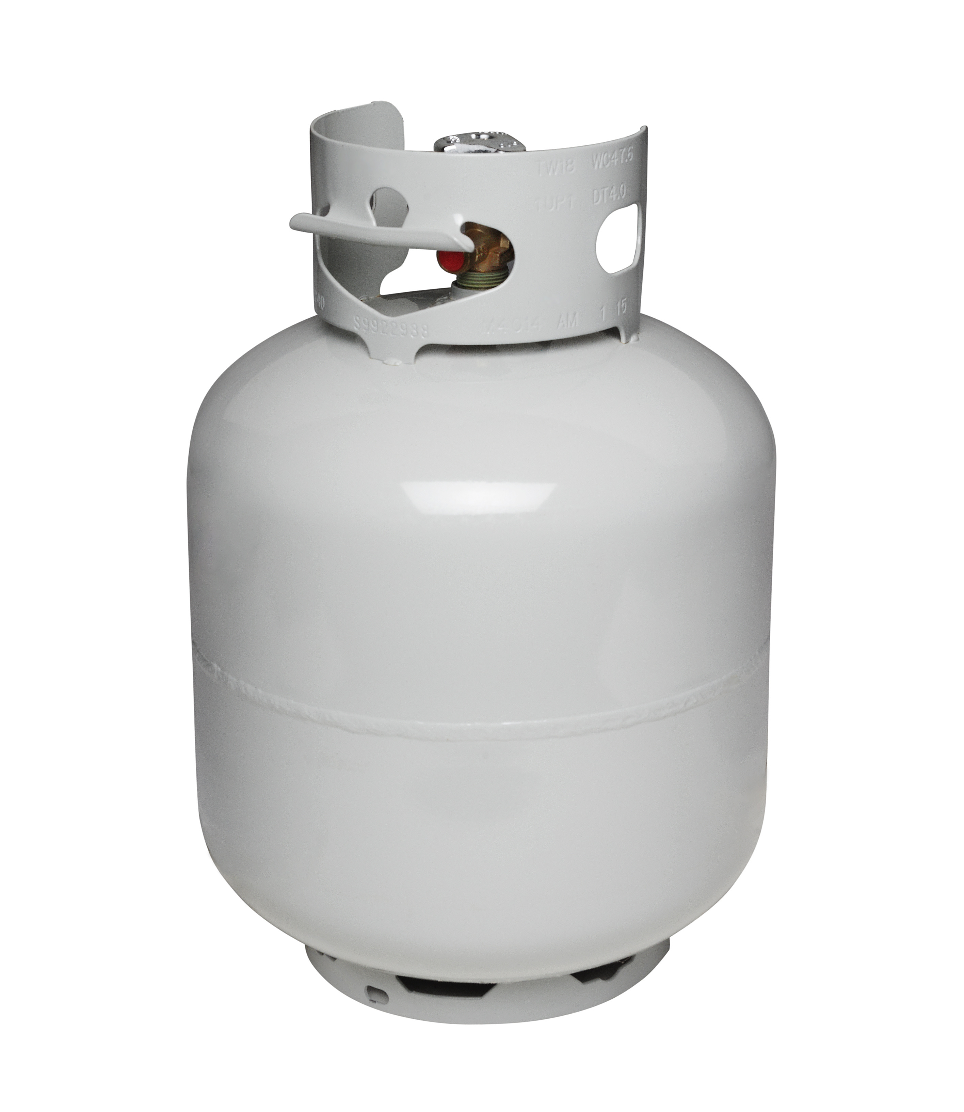
IDEAL GAS PROCESSES
Some Typical Systems with Constants
Hot air balloon has elastic surface and exposed to atmospheric pressure. P is constant
Sealed piston has moveable walls. P T V can change but number of moles is constant
Sealed solid container has constant volume. It has constant number of moles unless it leaks or gas is pumped

Slide 12
KEY STRATEGIES
Identify the variables for the initial state, label them with index "1"
Identify the variables for the final state, label them with index "2"
Use the ideal gas process equation. If anything is constant, cross it out from both sides.
Solve for the unknown. Unknown will have the unit of the other state variable

Slide 13
IDEAL GAS PROCESS CLASSWORK
3 Moles of gas has pressure 100,000 Pascal is at 250-degree Kelvin. What happens to the pressure if temperature is raised to 300-degree Kelvin and 0.5 moles of gas is added under constant volume.
P1=100,000Pa n1=3 T1=250K P2=? n2=3.5 T2=300K V1=V2
P1V1/(n1 T1) = P2 V2/(n2 T2) cross out the V's
Notes:
n1T1=750 n2T2=1050
100,000/(750) = P2/1050 P2=140,000 Pascal or 140kPa

Slide 14
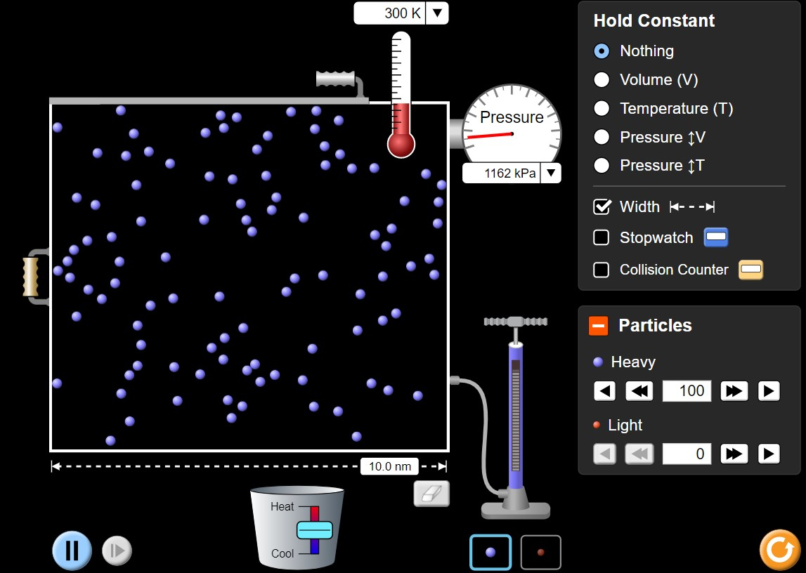
ACTIVITY IDEAL GAS PROCESSES
Open Phet simulation https://phet.colorado.edu/sims/html/gas-properties/latest/gas-properties_en.html
Click on ideal.
Click on width. The container is 10nm width, 10nm height and there is an unseen depth, which is 3.5nm
1nm=10^-9 meters. So the original box has volume V=0.035 10^⁻²³ m³
Click on particles. You can adjust number of particles inside the container
You may add heat to the system and observe the temperature change
The activity is about calculating the pressure and comparing with the values of the pressure gauge.
Change the units of pressure gauge to kilopascal kPa. 1kPa=1000 Pa.
Pressure is caused by particles hitting the walls of the container. If fluctuates statistical uncertainties. Make sure your calculated pressure is within the range of what pressure gauge reads. You can see a minimum pressure and maximum pressure.

Slide 15
ACTIVITY IDEAL GAS PROCESSES
Open Phet simulation https://phet.colorado.edu/sims/html/gas-properties/latest/gas-properties_en.html
Calculate Pressure using P1V1/(N1 T1)=P2V2/(n2 T2) for the problems below.
Simulate the problem using the app and compare the Pressure read from the gauge.
100 gas molecules is inside a container with 0.035 10⁻²³ m³ Volume
It has about 1200 kPa pressure at 300K temperature.
1) Find the new pressure if 50 more molecules are pumped at constant volume and temperature
2) Find the new pressure if 50 more molecules are pumped at constant volume but temperature is increased to 350K
3) Find the new pressure if 50 more molecules are pumped, temperature is raised to 350K and volume is halved.
4) Come up with your own questions. Compare you measure pressure with the pressure given by the pressure gauge.

Slide 16
CLASSWORK FOR KINETIC THEORY OF GAS
KE = 3/2 nRT = 3/2 NKT for monatomic gas
vrms = sqrt (3RT/Mm) Mm is the molar mass
Molar mass of a monatomic gas is 0.040 kg/mol
Calculate the Kinetic energy and root mean square velocity at
A) 300 K
B) 600 K
C) 10 K

Slide 17
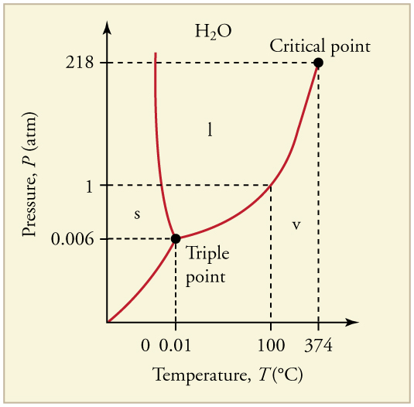
CLASSWORK FOR PHASE CHANGE
A substance has the triple point at 0.02 atm pressure and at 5 degrees Celcius temperature.
Q1) Draw an approximate P T diagram for the substance near its triple point.(Draw only near the triple point as a partial graph since the slopes will change as we move away from the triple point). Consider
A) Slope of the sublimation curve is 0.8 atm/C
B) Slope of the evaporation curve is 0.2 atm/C
C) Slope of the melting curve is –4 atm/C
Q2) Identify 6 points on the graph, one for each pure state and one for each phase transition
PT graph for water is given as reference, the image for the particular gas in the question will be different.

Slide 18
REFERENCES
Slide 1: Open Stax College Physics online textbook
Slide 8: Adobe id= 437739805 Gas equation on blackboard, ideal gas law equation, combine gas law equation, gas law of chemistry and physics By BN Benz
Slide 11 Left image: Open Stax College Physics online textbook
Slide 11 Middle image: Adobe id= 144540334 Inside view of engine cylinders, pistons and valves By OkFoto
Slide 11 Right image: Adobe id= 90387836 Propane gas cylinder, isolated on white By Christian Delbert
Slides 14-15: Screenshot from PhET Interactive Simulations University of Colorado Boulder
Slide 17: Open Stax College Physics online textbook

